Slide 1
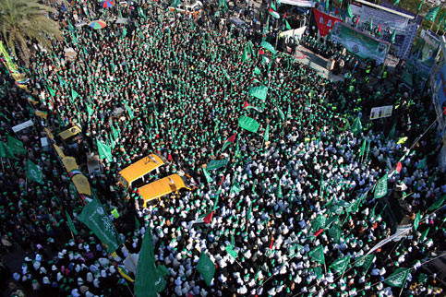
What happened in the 2006 Palestine election?
Lesson 14

Slide 2
Learning objectives
By the end of this lesson, you should be able to:
Describe Hamas
Explain the results of the 2006 election
Discuss the response to the election results

Slide 3
Keywords: Have you come across any of these before? Discuss this with the person sitting next to you
2006 Palestine election: a vote in January 2006 to elect the next Palestinian Legislative Council
Hamas: An Islamic Palestinian nationalist party
Ismail Haniyeh: Hamas’s spokesperson
Izz al-Din al-Qassam Brigades: The military wing of Hamas
Add these to your glossary

Slide 4
14a. Life under occupation In pairs, answer the questions below:
What is occupation? (You can use your glossary)
By 2006, Palestinians had been living under occupation or annexation* by Israel for many years. Match up the area of Palestine below with its year of occupation or annexation
3. What do you already know about the living conditions under occupation?
Invasion and temporary control over a territory
Life was very tough
As the size of Palestinian land got smaller due to increased Israeli settlements, Palestinian space became overcrowded
Due to the economic restrictions on Palestinians, there was high unemployment
*In 1980, Israel passed the Jerusalem Law which meant that it illegally annexed (forcibly acquired) East Jerusalem. This was condemned by UN Security Council Resolution 478 in 1980
West Bank
1967
Extension question: How do you imagine Palestinians felt after 39 years of living under occupation in 2006?
East Jerusalem
1967
Gaza
1980

Slide 5
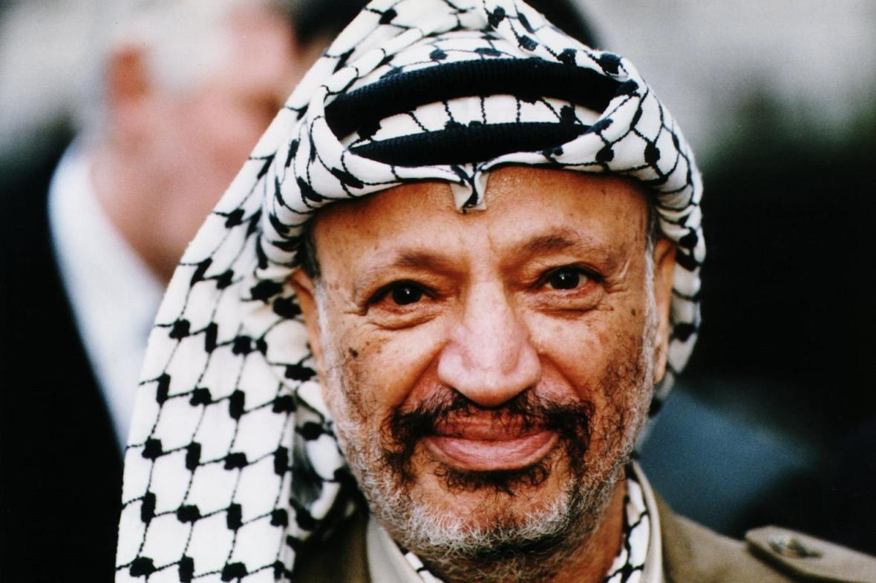
Palestinian nationalism
In small groups:
What can you remember about Palestinian nationalism? Use these images to help you

Slide 6
Palestinian nationalism
Yasser Arafat
A significant Palestinian leader, one of the founding members of Fatah
Fatah
A non-religious, Palestinian nationalist group. Fatah remains one of the most popular Palestinian political parties today

Slide 7
Hamas
When learning about the 2006 Palestine election, we need to look at Hamas
A Palestinian nationalist Islamic party, established in 1987
Hamas has been deemed a terror organisation by Israel, the US and EU
The Hamas flag

Slide 8
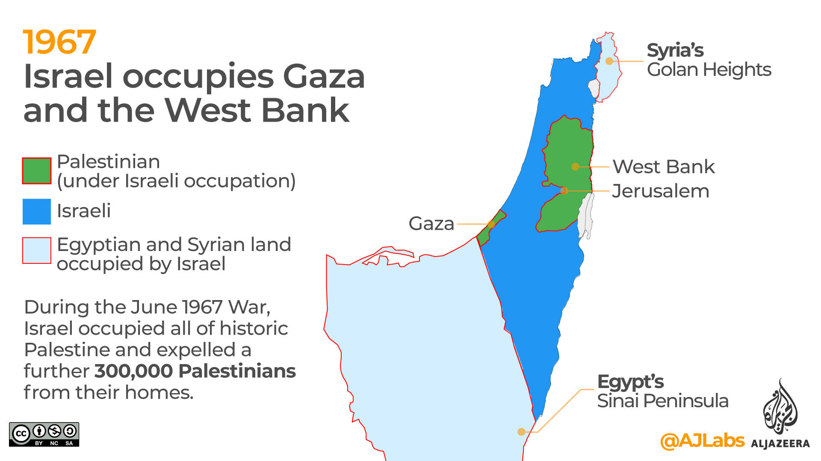
14b. The establishment and ideology of Hamas
At first, Hamas saw all Jews as enemies, wanted to rule all of historic Palestine and called for the destruction of Israel
However, this appears to have changed now
In 2007, Hamas described all Zionists (not Jews) as its enemies. It also said that it would accept a state of Palestine along the 1967 borders. But Hamas has still not recognised Israel
Answer these questions in the space provided on this sheet:
What is antisemitism?
What is the difference between being Jewish and being a Zionist?
What are the 1967 borders?
Extension question: what had happened in 1967?

Slide 9
From Lesson 2:
Jewish: someone who identifies as Jewish by religion or ethnicity
Antisemitism: hostility, prejudice or discrimination against someone because they are Jewish
Zionism: a nationalist movement to establish a Jewish state between the Mediterranean Sea and the River Jordan

Slide 10
Hamas activities
The Izz al-Din al-Qassam Brigades: a military wing who pursued armed struggle against Israel
An extensive social welfare programme: orphanages, nurseries, schools, library services, sports clubs, summer camps, soup kitchens, food banks and medical services

Slide 11
Hamas vs. Fatah
Whole class activity
Answer these questions: | Hamas | Fatah
Is it a religious movement?
Does it believe in armed struggle?
Does it recognise the state of Israel?
Does it accept the 1967 borders?
Yes, it is Islamic
No
Yes
Yes, but negotiations too
No
Yes
Yes
Yes

Slide 12
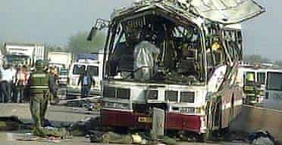
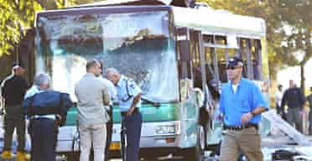
Suicide bombings
Hamas was responsible for many suicide bombings in Israel
In 2002, Hamas claimed responsibility for 19 of the 47 suicide bombings
Between 2000 and 2002, 415 Israeli and other citizens were killed, mostly from suicide bombings
8 Israelis were killed near Haifa, 10/4/02
11 Israelis were killed in Jerusalem, 21/11/02
Group discussion: how do you imagine Israelis felt about Hamas at this time?

Slide 13
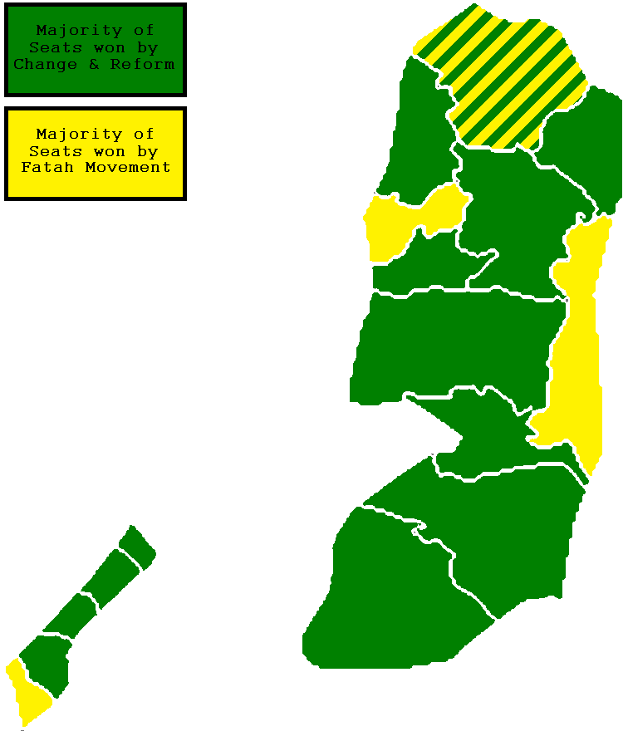
The 2006 Palestine election: what happened?
25th January 2006
The results:
Hamas (Change and Reform): 44%
Fatah: 41%
Others: 15%

Slide 14
Why were Hamas elected?
Palestinians were fed up with living under occupation. They wanted a change of government
Many Palestinians were impressed with Hamas’s social welfare programme
Corruption in Fatah
Think about this question with the person sitting next to you:
Are you surprised that Hamas won the 2006 election? Why/why not?

Slide 15
14c. How did the international community respond? Extracts from ‘Hamas celebrates election victory’ The Guardian, 26th Jan 2006
“Mr Bush said a party that advocated the destruction of Israel would never be partner for peace, but also hailed the result as an example of democracy in action”
When should democratic decisions be challenged?
In small groups, imagine it is 2006 and you are foreign policy advisers. How would you advise the following respond to the Hamas victory? Prepare to present your argument to the rest of the class
Israel
United States
EU
“…acting Israeli prime minister, said Israel could not trust a Palestinian leadership in which Hamas had a role. ‘Israel can't accept a situation in which Hamas, in its present form as a terror group calling for the destruction of Israel, will be part of the Palestinian Authority without disarming’”

Slide 16
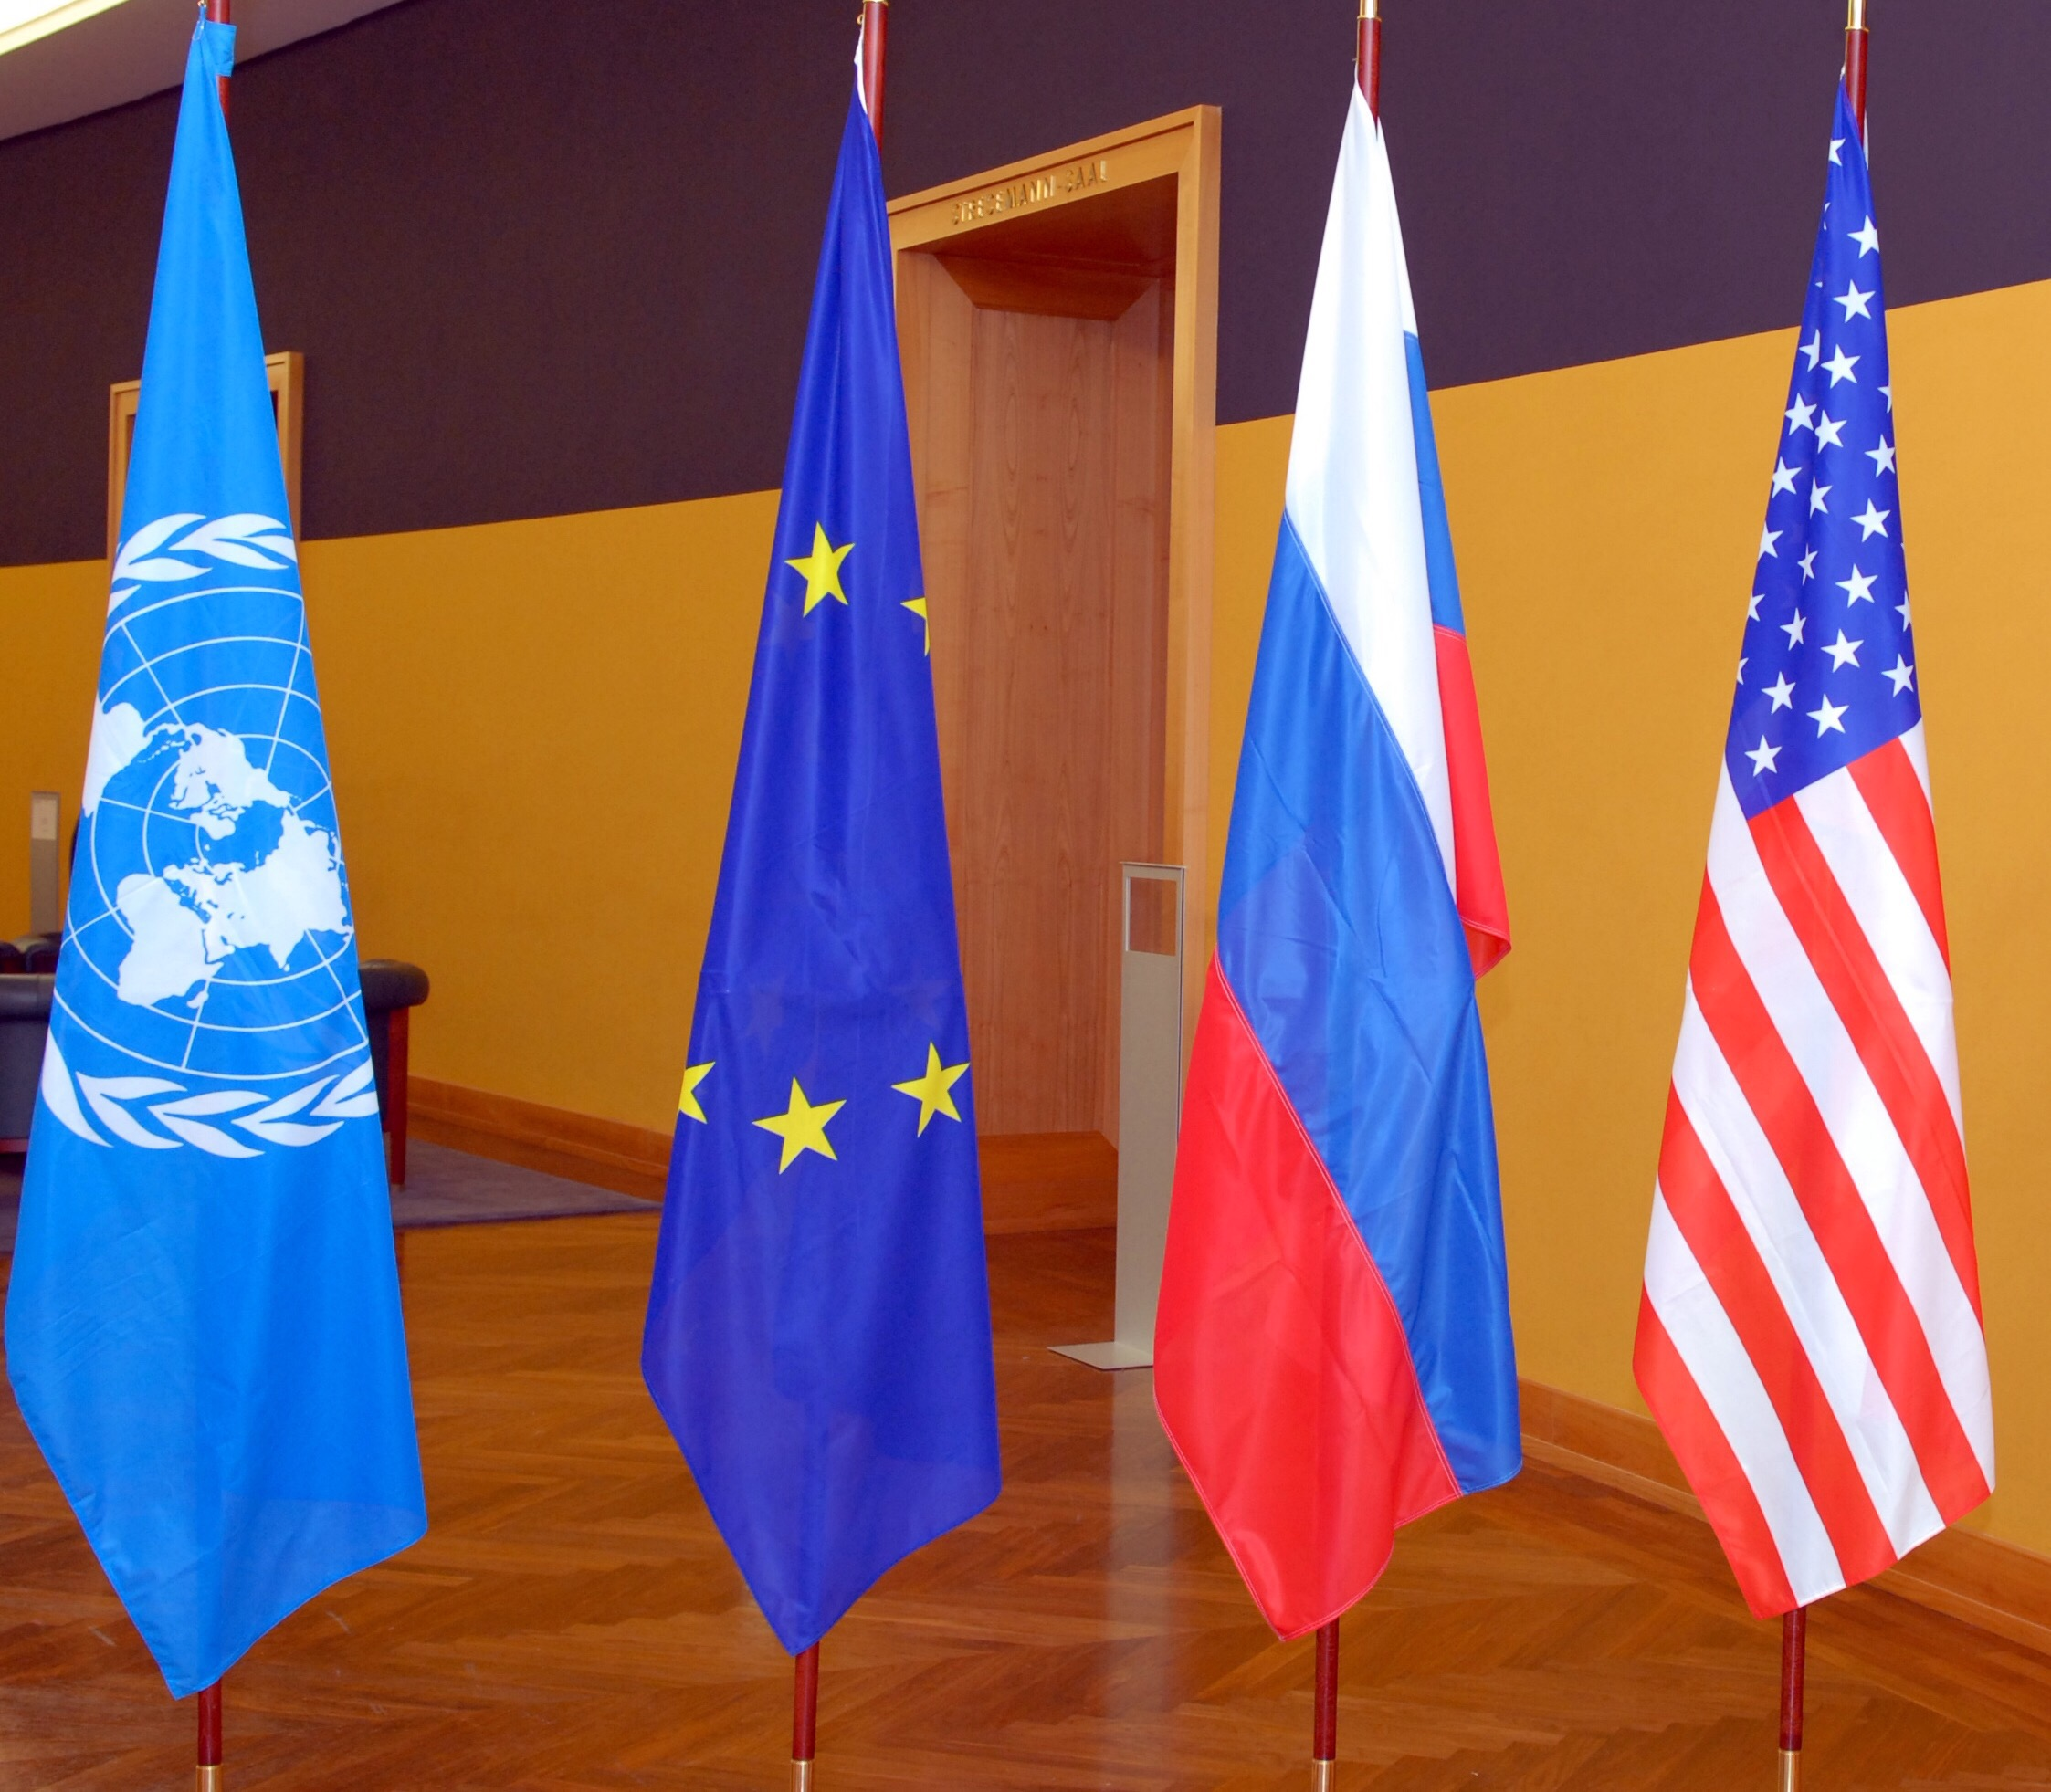
What was the response?
Fatah refused to work with Hamas: they were rivals!
Israel launched raids and arrested Hamas officials
The UN, US, EU & Russia said that unless Hamas recognised Israel and renounced violence, they would not work with it. Hamas refused to do this and so the international community withheld aid from Palestine
Eventually, Hamas took control of Gaza, and Fatah took control of the West Bank
Palestinians felt that this was unfair: they had democratically voted Hamas into power
What do you think? When should democratic decisions be challenged?

Slide 17
Plenary: 5 features
With the person next to you, can you summarise today’s lesson in 5 words?

Slide 18
Homework:
Answer these questions:
1.What is Hamas?
2.What were the results of the 2006 election?
3.How did the following respond to this:
Fatah
Israel
The international community

